Slide 1
ASSP Membership Benefits and Resources

Slide 2
Membership Benefits
Community
Education
Standards
Advocacy

Slide 3
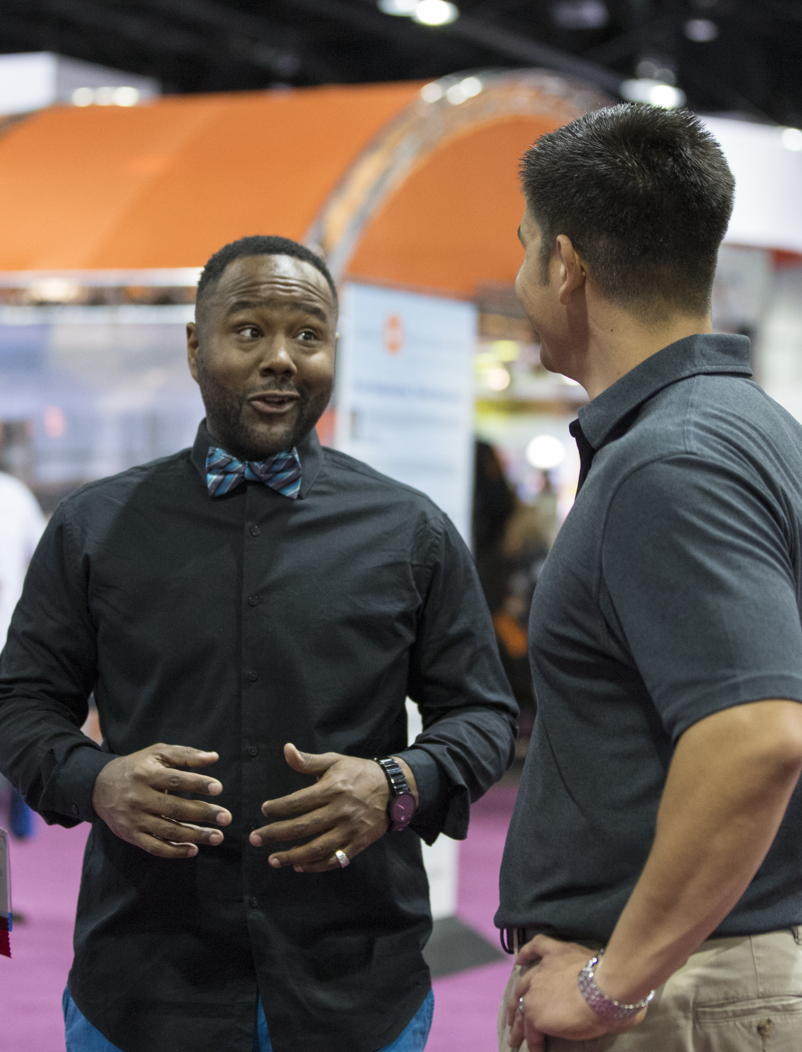
Our Community
29 Industry Specific Practice Specialties and common interest groups offering technical resources, networking, advice, and publications
ASSP is where occupational safety and health professionals find a vibrant community:
Over 38,000 members
150 chapters across nine U.S. and global regions
70 student sections
All industries and diverse voices across age, gender, and ethnicity
22 Common Interest Groups and Industry Specific Practice Specialties
65% of CSPs are members

Slide 4
Networking
29 Industry Specific Practice Specialties and common interest groups offering technical resources, networking, advice, and publications
Community and Networking Opportunities
Meet local OSH professionals through monthly chapter meeting’s
Practice Specialties offer the unique opportunity to network among OSH professionals in your industry
Common Interest Groups represent different age groups, ethnic backgrounds and genders to support diversity in the OSH profession

Slide 5
Career Resources
Career support
The ASSP job board is an online safety career center where employers can post job openings and members can search for jobs.
Search by location
Subscribe to the Jobs Flash eNewsletter
Recruit talent for your company

Slide 6
ASSP Foundation Scholarships and Grants
The ASSP Foundation had awarded more than $3 million in scholarships and professional education grants.
150 awards ranging from $500-$15,000
Apply between September 1-December 1
More than $370,000 available
Academic scholarships
Professional education grants

Slide 7
Student Membership Benefits
Build professional network with 38,000 members
Student membership costs $6 or $15
Free access to on-demand webinars
One free practice specialty and common interest group
Reduced rates to annual Professional Development Conference
Future Safety Leaders Conference
Free year of full membership after graduation

Slide 8
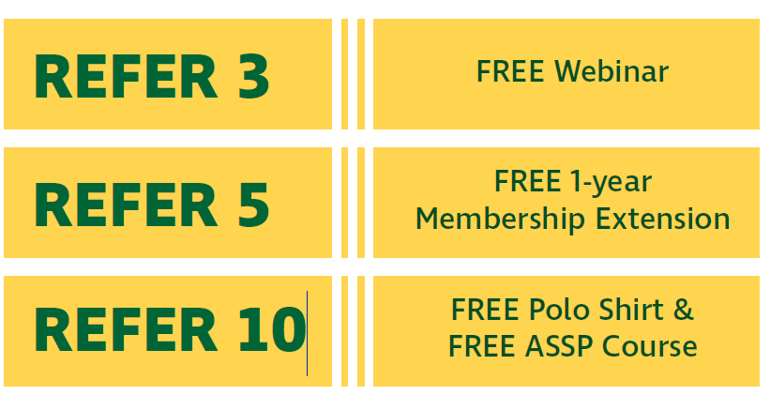
Member-Get-A-Member
Refer your peers to ASSP and earn rewards

Slide 9
Get Certified
Members save on Certification Preparation Courses
Math Review
ASP, CSP, CHST, OHST, and SMS Prep Courses
Enjoy Discounts on Certification Study Materials
Reduce the Cost of Certification Programs
Certificate in Safety Management, Executive Program in Safety Management, Global Safety Management, Fall Protection, ISO 45001, Risk Assessment
Earn Continuing Education Credits to Maintain Certification
By being an ASSP Member
Attending workshops/training
Contributing content to Professional Safety Journal
Attending Local Chapter meetings

Slide 10
Learn Online
Maximize your training dollars with Virtual Classroom Training:
Webinars
LearnEx courses
Microlearning
On-demand sessions
Symposia
Business training modules
Your entire team can participate with just one registration for some offerings
New members receive one free on-demand educational webinar ($115 value)

Slide 11
Free Learning Resources

Slide 12
Access the Latest Technical Knowledge
Professional Safety Journal:
#1 ranked OSH Journal
Monthly and archived online
Topics include: Best practices, Safety Management, Health & Wellness, Leadership, Rules & Regulations, Standards, Industry Notes, and New Product Innovations
Practical Content
Society Update
Chapter Services Update
Student Services Update
ASSP Weekly

Slide 13
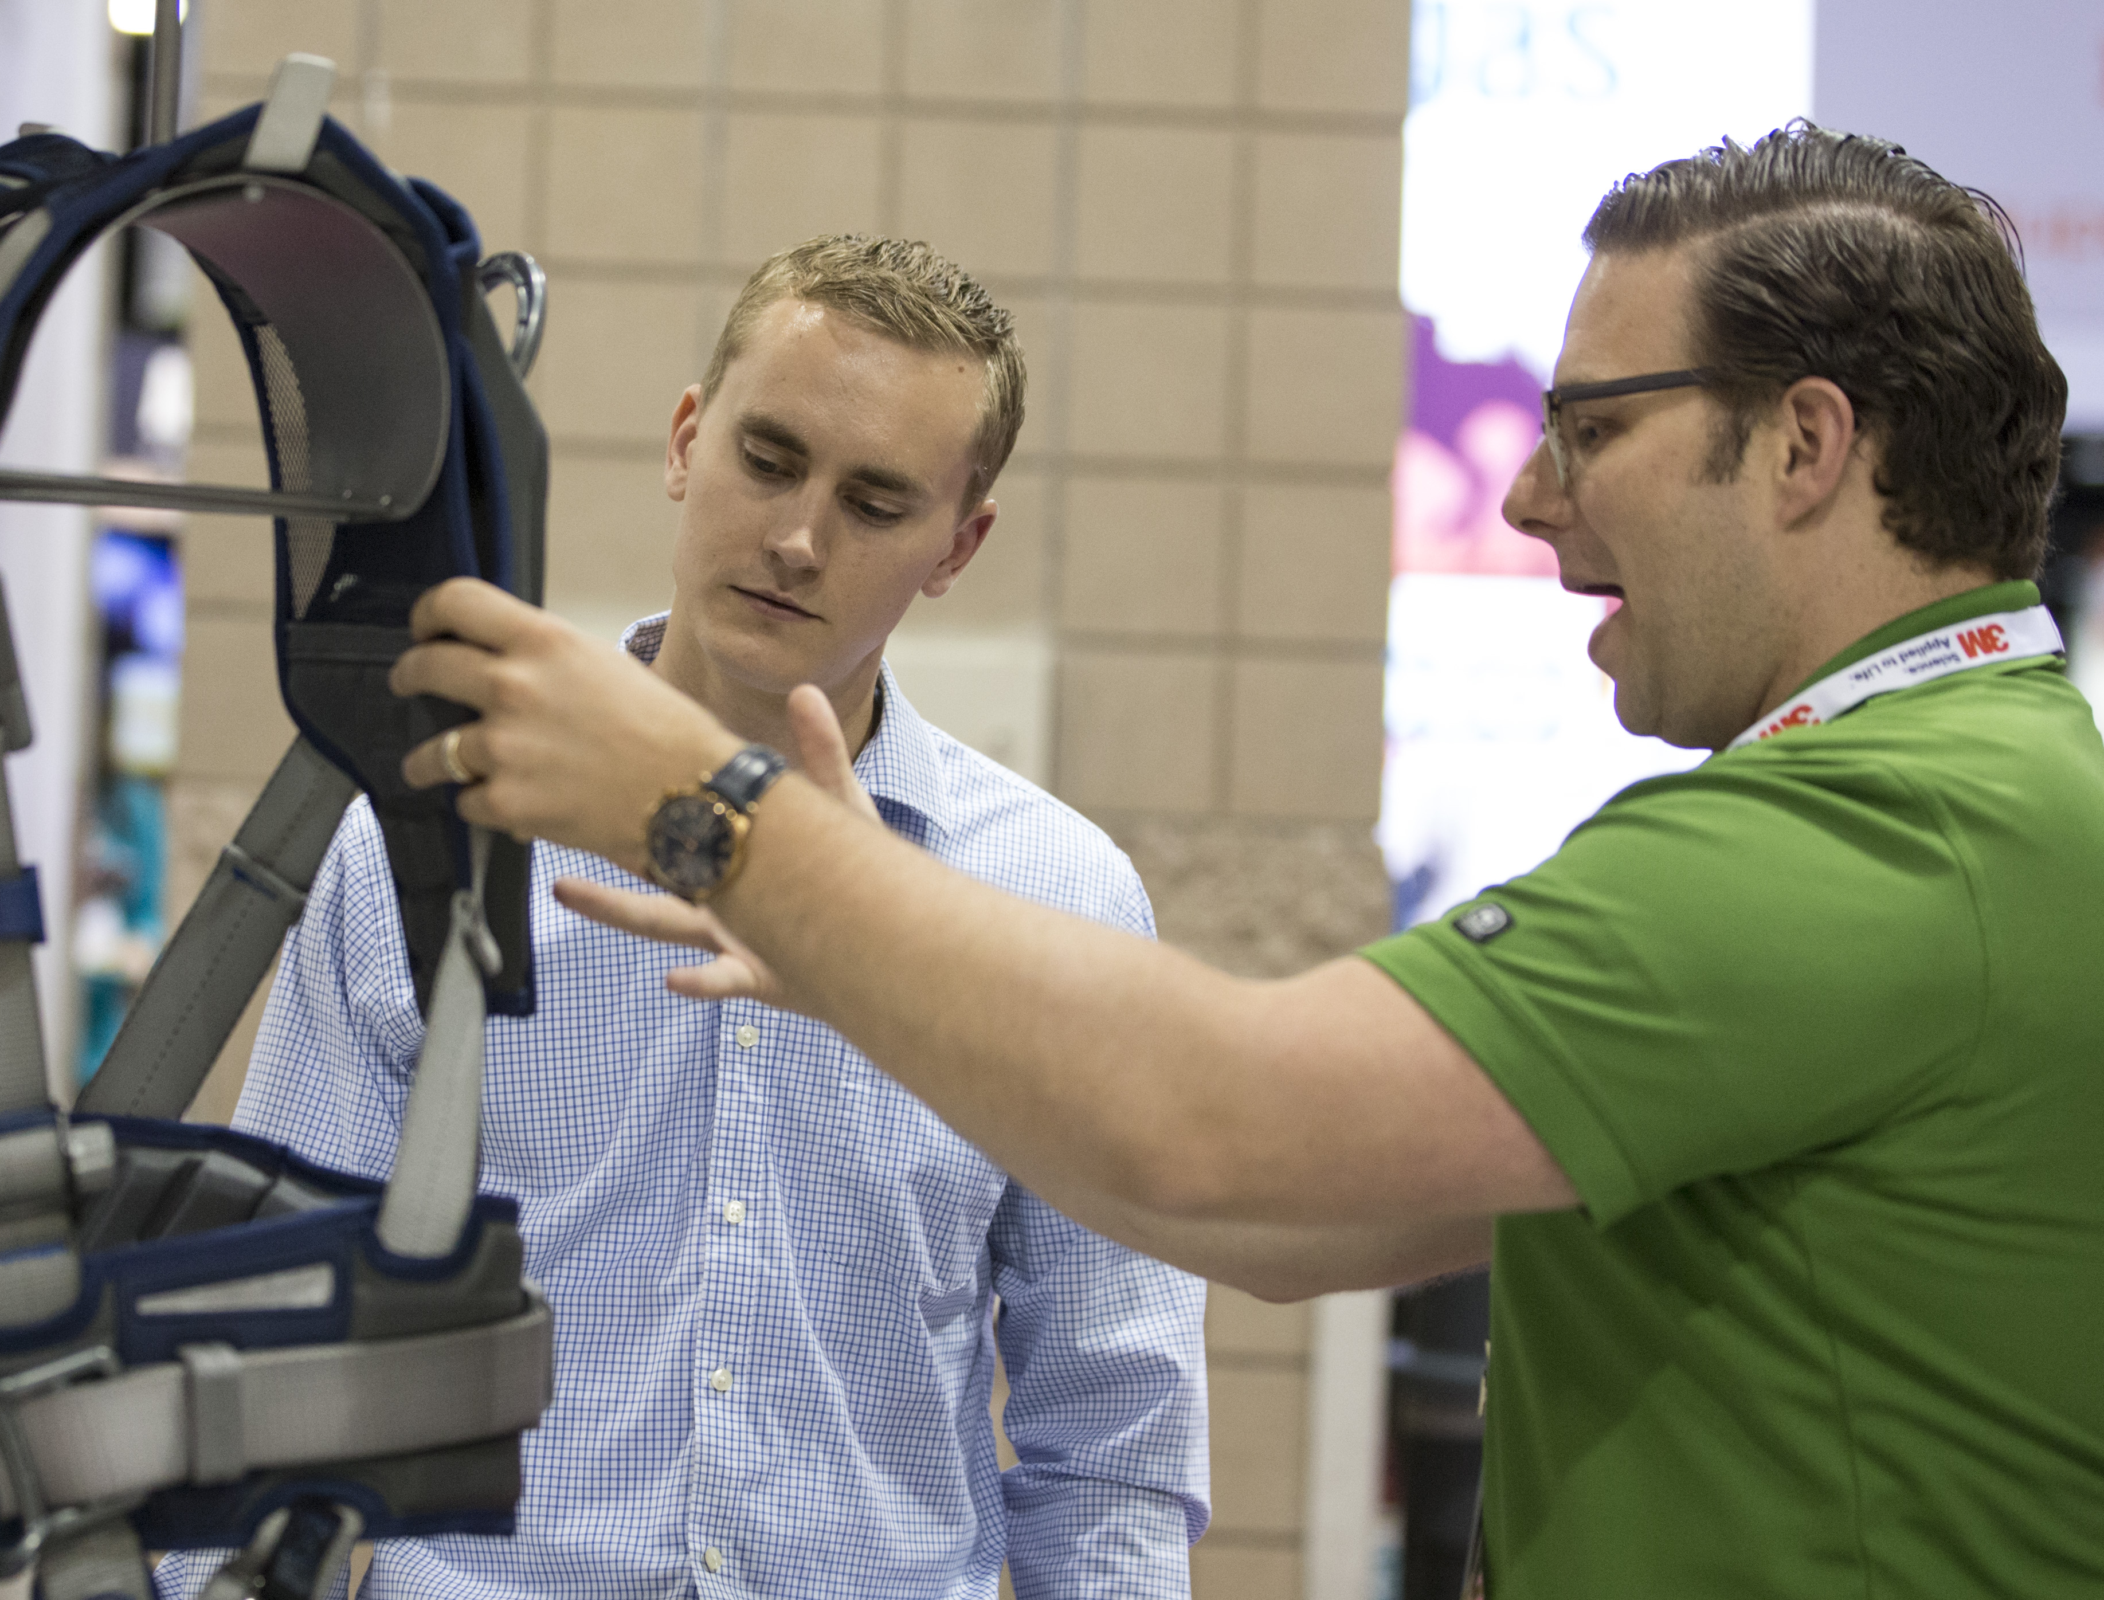
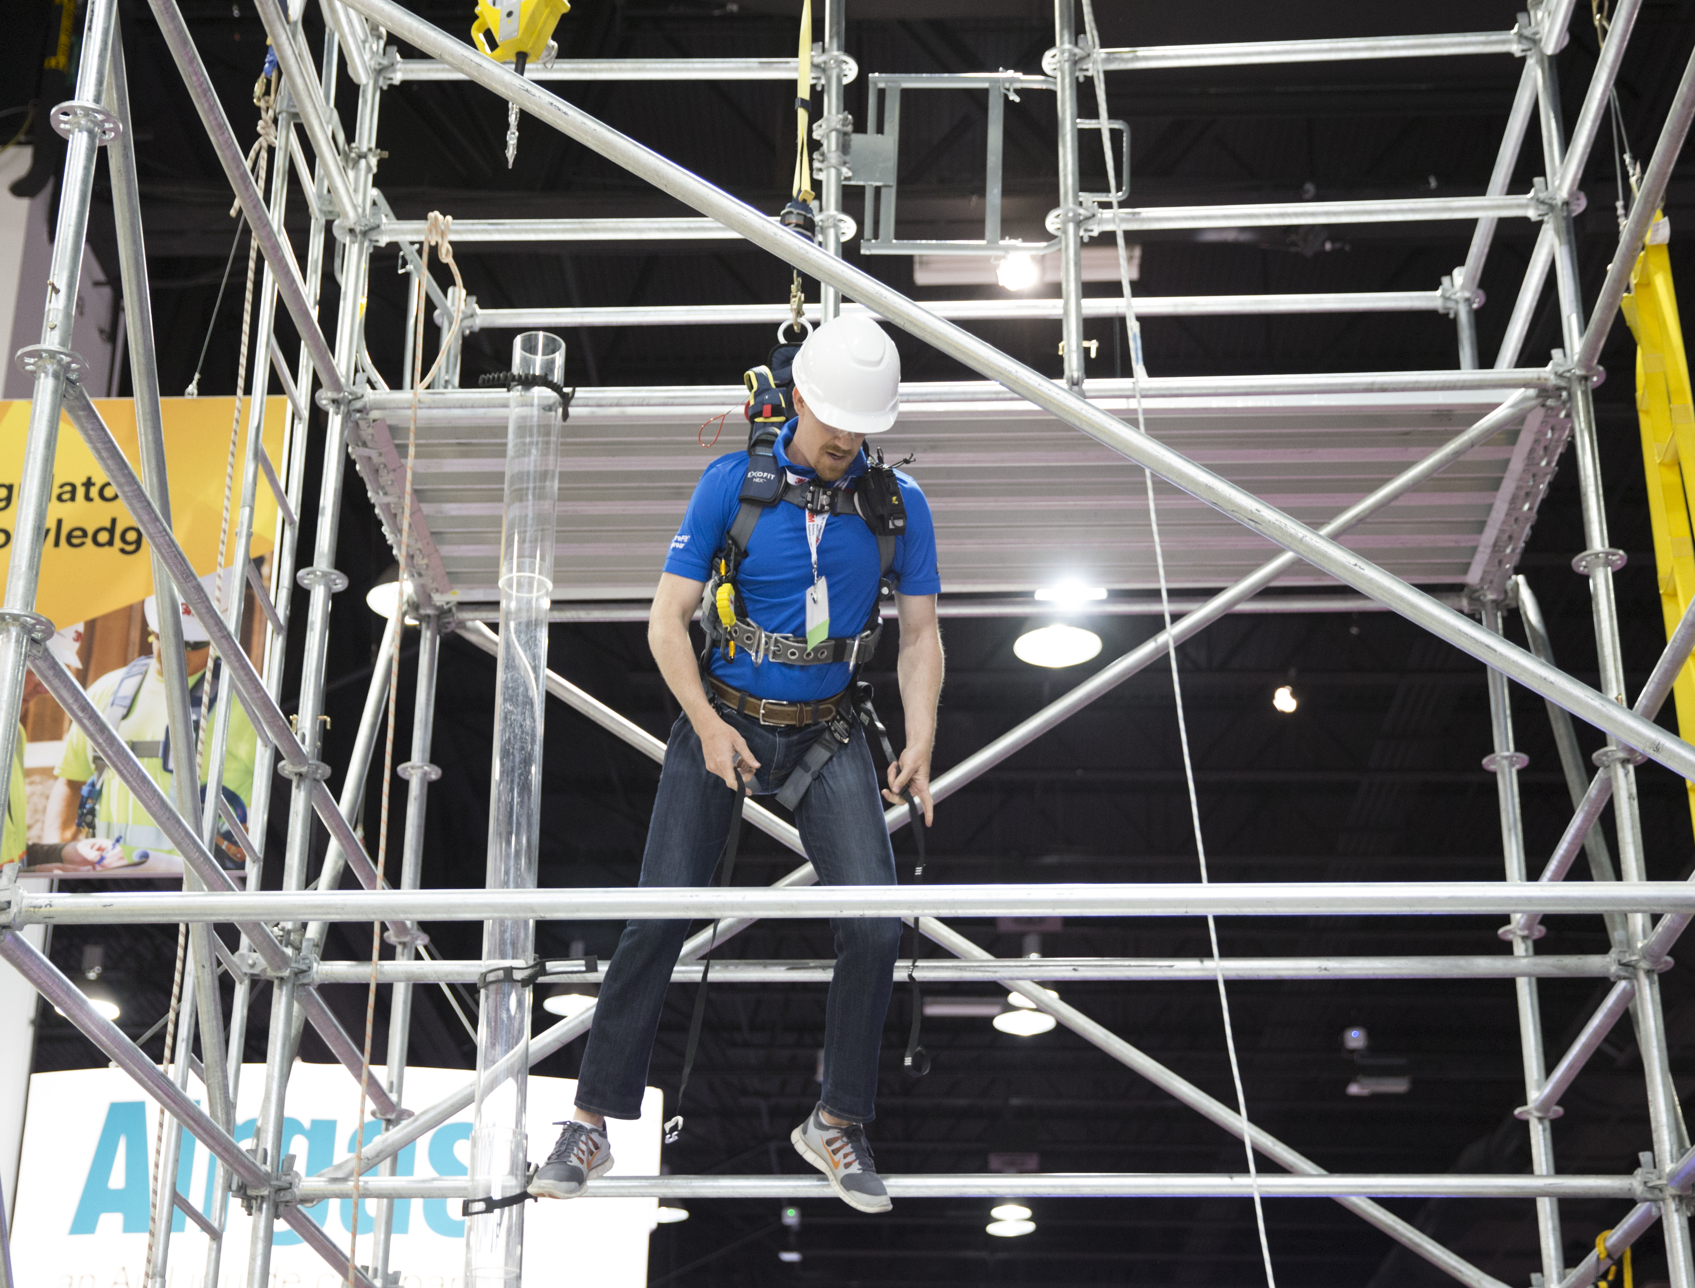
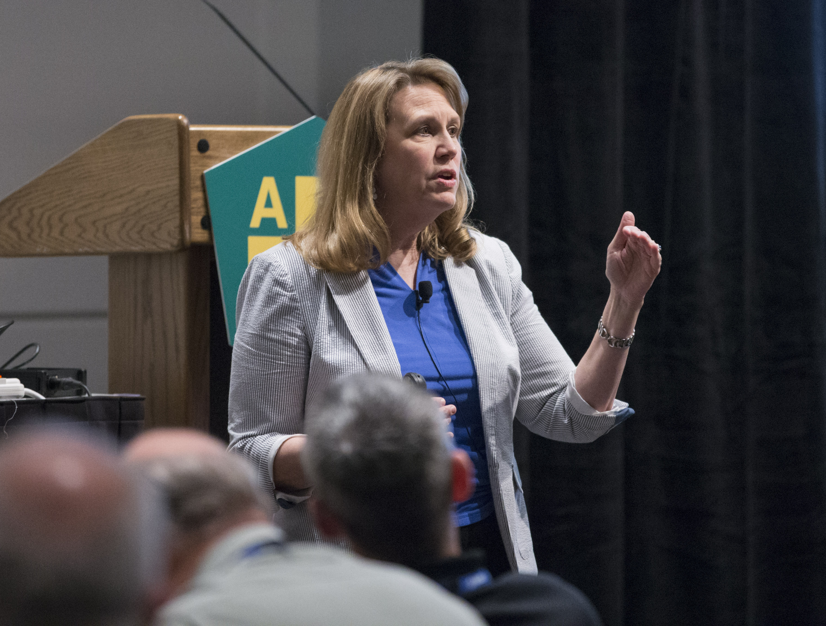
Attend Top Industry Events
ASSP Annual Professional Development Conference & Exposition
More than 220 concurrent sessions focused on 20 different subject areas
300+ speakers and 600+ exhibitors presenting the latest products, technology and techniques
Engage with more than 8,000 attendees and industry experts
SeminarFest
Choose from 90+ courses for 10+ areas of focus
Participate in full-day courses across an entire week
Network with 1,200+ OSH professionals
Members save $140+ on Event Registration

Slide 14
Standards Development
ASSP Standards aim to drive improved performance for all of our members. Our standards portfolio includes:
Aerial Work Platforms
Construction & Demolition Operations (A10)
Fall Protection & Fall Restraint (Z395)
Machine Guarding (B11)
Personal Protective Equipment
Respiratory Protection (Z88)
Risk Management & Risk Assessment
Safety Management
Safety Practices, Procedures & Training
Slip & Trip Prevention (A1264)
Ventilation Systems (Z9)

Slide 15
Advocacy
Latest news & information in OSH Governmental regulations
State Legislative and Regularity Activity Reports
Opportunity to get your voice involved in the Governmental Affairs Committee

Slide 16
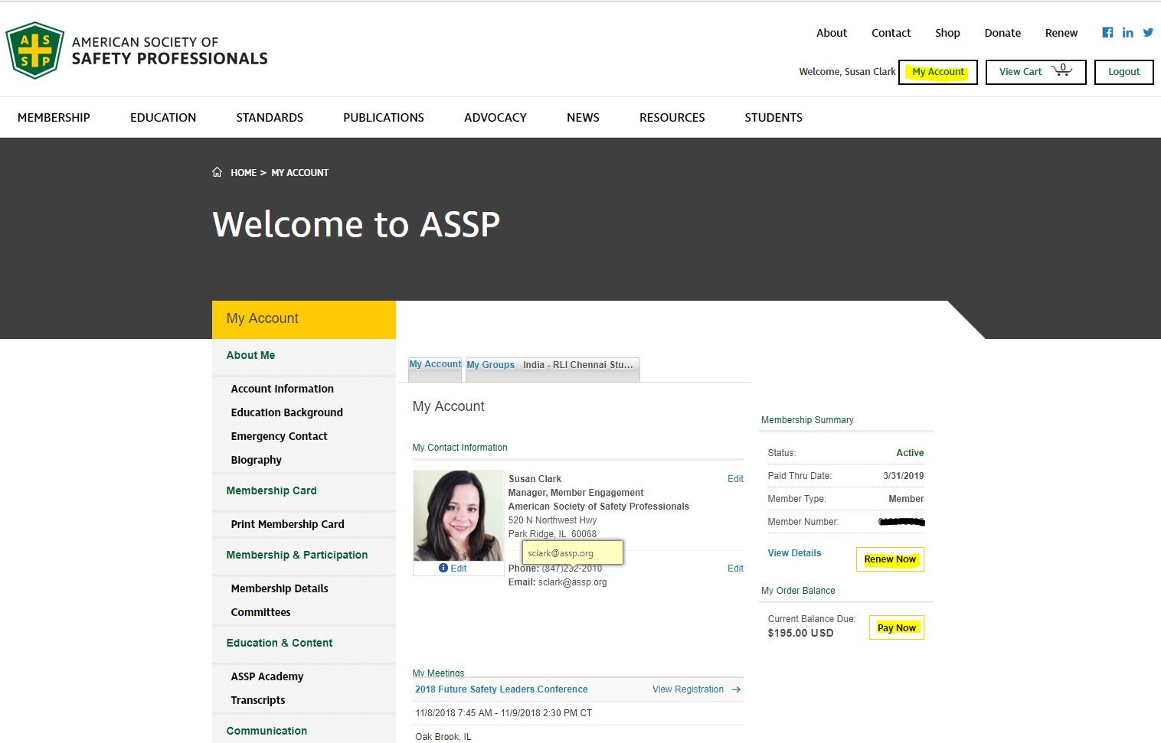
Renew Now & Pay Now

Slide 17
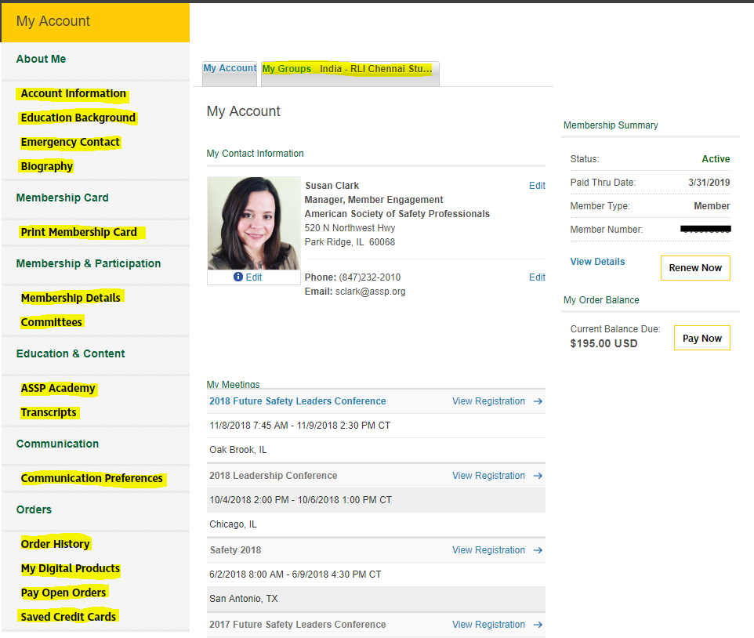
Account Information

Slide 18
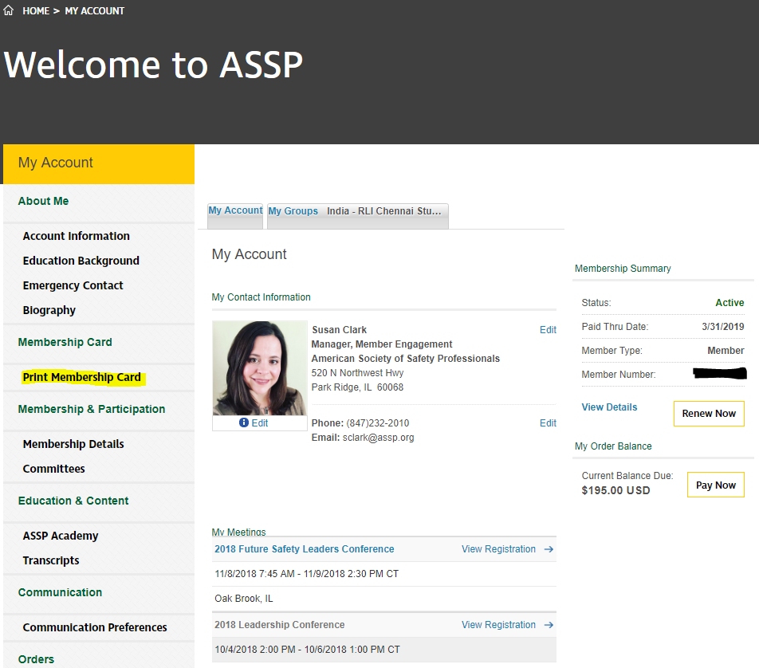
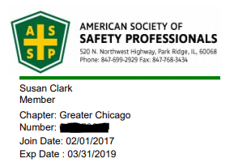
Print Electronic Membership Card

Slide 19
Community Leader Resources

Slide 20
Thank You!
Susan Clark
Manager, Member Engagement
sclark@assp.org
+1-847-232-2010

